Slide 1

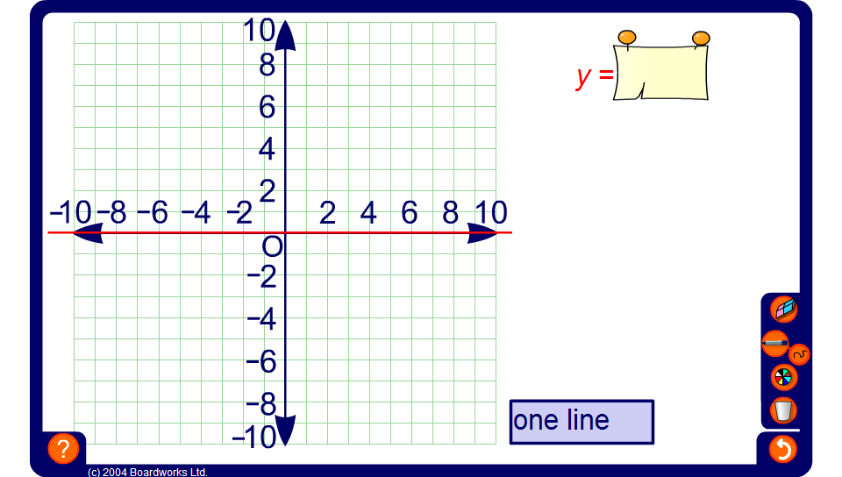


Investigating straight-line graphs
Notes:
Remind pupils that the the equation of a graph tells us the relationship between the x-coordinate and the y-coordinate of every point on that line. If the x- and y-coordinates of a point do not satisfy the equation of the line then the point cannot lie on the line. Also, the equation of a line represents an infinite set of points.
A function is linear if the variables are not raised to any power other than 1 (not usually written).
Investigating the gradient
Ask a volunteer to drag the line on the board so that it has a gradient of 2. Point out that this means that for every square we move along the line we move two squares up.
Add another line and ask another volunteer to drag the line to a different position and drag the end points to again produce a line with a gradient of 2.
Ask pupils what they notice about the lines. Establish that lines with the same gradient are parallel.
Look at the equation of each line. Ask pupils what they notice about the equations. Establish that the multiplier (the coefficient) of x is 2 for each line. The constant value that is added on in each case varies depending on where the line meets the vertical axis (the y-axis). All of the lines are of the form y = 2x + c, where c indicates where the line cuts the y-axis.
Clear the lines from the graph.
Drag the lines up and down to different positions to show that two parallel lines will always have the same coefficient for x.
Repeat for different gradients.
Investigating the y-intercept
Define the y-intercept as the point where a line crosses the y-axis. Ask a volunteer to drag the line on the board so that it crosses the y-axis at the point (0, 2). State that the y-intercept of this line is 2.
Add another line and ask another volunteer to drag the line and vary the gradient to produce another line with a y-intercept of 2.
Reveal the equations of each line.
Drag the end points of the lines to change the gradient, while keeping the y-intercept fixed. Ask pupils what they notice about the equations of the lines, that is that all of the lines are of the form y = mx + 2. Conclude that the value of c tells us where the line cuts the y-axis.
Clear the board and repeat, if required, with a different intercept, for example, –3. Note that, again, the multiplier (the coefficient) of x changes and the number that is added on the stays the same.

